Slide 1
2017 Updates
Herman A. McKenzie, MBA,CHSP Department of Engineering

Slide 3
Leadership Vision
Develop one single, comprehensive method of categorizing the risk associated with standards

Slide 4
Project Overview
Address customer concerns
Address contemporary issues in our standards
Reduce complexity
Streamline manual
Hospital program
Occurring in phases
Did not affect Elements of Performance (EPs) directly related to Medicare Requirements (CoPs)

Slide 5
Survey Analysis For Evaluating Risk (SAFER) Matrix & Post-Survey Follow-up
For more information see January 2017 Perspectives

Slide 6
A New SAFER Model
 |  | Immediate Threat to Life (follows current ITL processes)
Likelihood to Harm a Patient/Visitor/Staff | HIGH
 | MODERATE
 | LOW
 |  | LIMITED | PATTERN | WIDESPREAD
17

Slide 7
How is Risk Determined?
Operational definitions and “anchors”
Surveyor experience and expertise will provide the support to determine the “scope” and “likelihood to harm” for the finding
Based on the context of the finding
Discussion amongst the survey team

Slide 8
Customer Impacts as of 1/1/2017
No more Direct and Indirect EP designations
All ESC now 60-day time frame
Consolidated Evidence of Standards Compliance (ESC) into one time frame
No more Measures of Success (MOS)
No more Opportunities for Improvement (OFIs)
See it / Cite it Survey Methodology
No more ‘A’ or ‘C’ categories

Slide 9
Reducing Post-Survey Clarifications

Slide 10
What is Clarification?
“After a survey event, organizations have the opportunity to submit clarifying ESC if they believe that their organization was in compliance with a particular standard at the time of Survey.”
ACC-60

Slide 11
Hospital Clarifications
In 2016
50% of Hospital Accreditation Programs (HAP) request Clarifications
51% of HAP Clarifications are in the Environment of Care (EC) and Life Safety (LS) Chapters
Dominant clarification themes:
Lack of Documentation (65%)
Incorrect Findings
Survey Process Issues

Slide 12
Documentation
Embedded in the EPs is the icon
NFPA* requires documentation be available “UPON REQUEST”
*See NFPA 25-2011 4.3 and NFPA 72-2012 14.6.3.2
Required Documents not available at the time of survey generate Requirements for Improvements (RFIs) that are not eligible for clarification
The organization should review the “Checklist of Required Documentation” prior to the start of survey
In off-survey years, discussion of Required Documentation during Intracycle Monitoring (ICM) events may occur

Slide 13
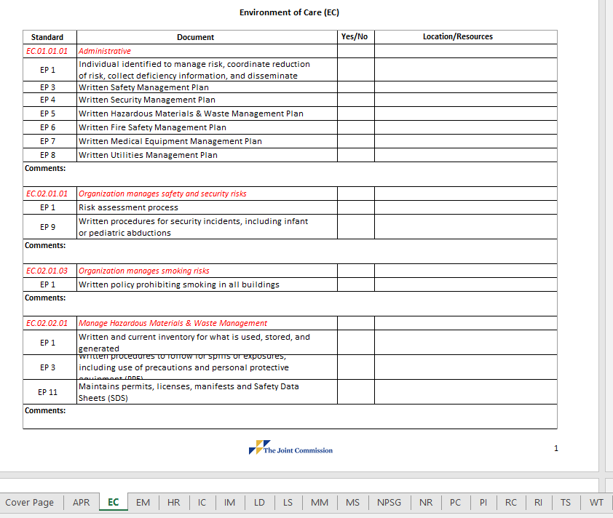
Pre-Survey Checklist

Slide 14
LS.02.01.10 EP 1: ED Occupancy
Health Care
Facilities that provide sleeping accommodations for persons who are mostly incapable of self-preservation, or that provide housing on a 24-hour basis for occupants, are classified as health care occupancies, per National Fire Protection Association (NFPA) 101-2012, 18/19.1.1.1.5 and 18/19.1.1.1.9.
See also Joint Commission Online, May 24, 2017
www.jointcommission.org/issues

Slide 15
LS.03.01.10 EP 1: ED Occupancy
Ambulatory Health Care
Used to provide services or treatment simultaneously to four or more patients that provides, on an outpatient basis, one or more of the following:
Treatment for patients that renders the patients incapable of taking action for self-preservation under emergency conditions without the assistance of others
Anesthesia that renders the patients incapable of taking action for self-preservation under emergency conditions without the assistance of others

Slide 16
LS.03.01.10 EP 1: ED Occupancy
Ambulatory Health Care
Used to provide services or treatment simultaneously to four or more patients that provides, on an outpatient basis, one or more of the following:
Emergency or urgent care for patients who, due to the nature of their injury or illness, are incapable of taking action for self-preservation under emergency conditions without the assistance of others.

Slide 17
EC.01.01.01 EP 3
PROPOSED
The organization has a library of
service manuals
instructions manuals
procedures provided by manufacturer’s, maintenance manuals
technical bulletins
specification information and other information for the inspection, testing and maintenance of equipment and systems
See NFPA 99-2012 10.5.3 and 10.5.6.

Slide 18
EC.02.05.05 EP 7
PROPOSED
The hospital meets all other HealthCare Facilities Code requirements for electrical distribution, HVAC, as related to NFPA 99-2012: Chapters 6 and 9.
Note: For hospitals that use Joint Commission accreditation for deemed status purposes: the hospital meets the applicable provisions of the Life Safety Code Tentative Interim Amendments (TIAs) 12-2 and 12-3.

Slide 19
EC.02.03.03 EP 4 (K933)
PROPOSED
Periodic evaluations are made related to fire loss prevention in operating rooms, including hazards that could be encountered during surgical procedures, and fire prevention procedures are established.
Procedures are established for operating room emergencies including alarm activation, evacuation, equipment shutdown, and control operations.
Emergency procedures include the control of chemical spills, and extinguishment of drapery, clothing and equipment fires.
Notes:
19

Slide 20
EC.02.03.03 EP 4 (K933)
PROPOSED
Continued …
Training is provided to new OR personnel (including surgeons), continuing education is provided, incidents are reviewed monthly, and procedures are reviewed annually.
When flammable germicides or antiseptics are employed during surgeries utilizing electrosurgery, cautery or lasers:
packaging is non-flammable
applicators are in unit doses
….
Notes:
20

Slide 21
EC.02.03.03 EP 4 (K933)
PROPOSED
Preoperative "time-out" is conducted prior the initiation of any surgical procedure to verify:
application site is dry prior to draping and use of surgical equipment
pooling of solution has not occurred or has been corrected
solution-soaked materials have been removed from the OR prior to draping and use of surgical devices
policies and procedures are established outlining safety precautions related to the use of flammable germicide or antiseptic use.
(For full text refer to NFPA 99-2012: 15.13)
Notes:
21

Slide 22
EC.02.05.01 EP 23 (K913)
PROPOSED
Operating rooms are considered wet procedure locations, unless otherwise determined by a risk assessment conducted by the facility governing body.
Operating rooms defined as wet locations are protected by either isolated power or ground-fault circuit interrupters.
A written record of the risk assessment is maintained and available for inspection. (For full text refer to NFPA 99-2012: 6.3.2.2.8.4, 6.3.2.2.8.7, 6.4.4.2)
Notes:
22

Slide 23
EC.02.05.01 EP 26
PROPOSED
All power strips are used with general precautions.
Extension cords are not used as a substitute for fixed wiring of a structure.
Extension cords used temporarily are removed immediately upon completion of the purpose for which it was installed and meets the conditions of 10.2.4.
(For full text refer to NFPA 99-2012: 10.2.3.6; 10.2.4; NFPA 70-2011: 400-8; 590.3(D), Tentative Interim Amendment (TIA) 12-5)
Notes:
23

Slide 24
EC.02.05.05 EP 7 (K914, K912)
PROPOSED
Hospital-grade receptacles at patient bed locations and where deep sedation or general anesthesia is administered, are
Tested after initial installation, replacement or servicing
Additional testing is performed at intervals defined by documented performance data
Receptacles not listed as hospital-grade at these locations are tested at intervals not exceeding 12 months.
Line isolation monitors (LIM), if installed, are tested at intervals of ≤ 1 month by actuating the LIM test switch per 6.3.2.6.3.6, which activates both visual and audible alarm.
Notes:
24

Slide 25
(cont.)
PROPOSED
For LIM circuits with automated self-testing, this manual test is performed at intervals ≤ 12 months.
LIM circuits are tested per 6.3.3.3.2 after any repair or renovation to the electric distribution system.
Records are maintained of required tests and associated repairs or modifications, containing date, room or area tested, and results.
(For full text refer to NFPA 99-2012: 6.3.2; 6.3.3; 6.3.4)
Notes:
25

Slide 26
EC.03.01.01 EP 1
PROPOSED
Personnel responsible for the maintenance, inspection and testing and use of medical equipment, utility systems and equipment, fire safety systems and equipment, and the safe handling of hazardous materials and waste are competent and receive continuing education and training.
(K50, K712, K718, K901, K907, K920, K921, K926, K933)
Notes:
26

Slide 27
1/9/17 Release: EC.02.04.01 EP 5
The hospital’s activities and frequencies for inspecting, testing, and maintaining the following items must be in accordance with manufacturers’ recommendations:
Equipment subject to federal or state law or Medicare Conditions of Participation in which inspecting, testing, and maintaining must be in accordance with the manufacturers’ recommendations, or otherwise establishes more stringent maintenance requirements

Slide 28
EC.02.04.01 EP 3
The hospital identifies high-risk medical equipment on the inventory for which there is a risk of serious injury or death to a patient or staff member should the equipment fail. NOTE: High-risk medical equipment includes life support equipment.

Slide 29
EC.02.04.01 EP 4
The hospital identifies the activities and associated frequencies, in writing, for maintaining, inspecting, and testing all medical equipment on the inventory. These activities and associated frequencies are in accordance with manufacturers’ recommendations or with strategies of an alternative equipment maintenance (AEM) program.

Slide 30
EC.02.04.01 EP 4
Note 1: The strategies of an AEM program must not reduce the safety of equipment and must be based on accepted standards of practice, such as the American National Standards Institute/Association for the Advancement of Medical Instrumentation handbook ANSI/AAMI EQ56: 2013, Recommended Practice for a Medical Equipment Management Program. Note 2: Medical equipment with activities and associated frequencies in accordance with manufacturers’ recommendations must have a 100% completion rate.

Slide 31
EC.02.04.01 EP 4
Note 3: Scheduled maintenance activities for both high-risk and non-high-risk medical equipment in an alternative equipment maintenance (AEM) program inventory must have a 100% completion rate. AEM frequency is determined by the hospital AEM program.

Slide 32
1/9/17 Release: EC.02.04.01 EP 5
Medical laser devices
Imaging and radiologic equipment (whether used for diagnostic or therapeutic purposes)
New medical equipment with insufficient maintenance history to support the use of alternative maintenance strategies
Note: Maintenance history includes any of the following documented evidence:
Records provided by the [ORGANIZATION]’s contractors
Information made public by nationally recognized sources
Records of the [ORGANIZATION]’s experience over time

Slide 33
1/9/17 Release: EC.02.04.03 EP 3
The [ORGANIZATION] inspects, tests, and maintains non–high-risk equipment identified on the medical equipment inventory. These activities are documented. Note: Scheduled maintenance activities for non-high risk medical equipment in an alternative equipment maintenance (AEM) program inventory may be deferred as defined by organization policy, provided the completion rate is not less than 90%.

Slide 34
CMS Response
Note allows for completion rate of 90% for AEM for non-high-risk medical equipment. CMS indicated that 100% of the maintenance has to be completed and that AEM is performed at a frequency defined by the organization’s AEM program.

Slide 35
EC.02.04.03 EP 3
The hospital inspects, tests, and maintains non-high-risk equipment identified on the medical equipment inventory. These activities are documented. Note: Scheduled maintenance activities for non-high-risk medical equipment in an alternative equipment maintenance (AEM) program inventory must have a 100% completion rate. AEM frequency is determined by the hospital’s AEM program.

Slide 36
EC.02.04.03 EP 14
The hospital meets all other HealthCare Facilities Code requirements; facilities code for electrical equipment in the patient care vicinity as related to NFPA 99-2012: Chapter 10.
Note: For hospitals that use Joint Commission accreditation for deemed status purposes: the hospital meets the applicable provisions of the Life Safety Code Tentative Interim Amendment (TIA) 12-5.

Slide 37
Relocatable Power Taps
RPTs may be used for non-patient care equipment such as computers/monitors/printers, and in areas such as waiting rooms, offices, nurse stations, support areas, corridors, etc.
Precautions needed if RPTs are used include:
ensuring they are never “daisy-chained”
preventing cords from becoming tripping hazards
installing internal ground fault and over-current protection devices
using power strips that are adequate for the number and types of devices used

Slide 38
Definitions From NFPA 99-2012
Patient bed location is defined in section 3.3.136 as the location of a patient sleeping bed, or the bed or procedure table of a critical care area
Patient-care-related electrical equipment is defined in section 3.3.137 as electrical equipment that is intended to be used for diagnostic, therapeutic, or monitoring purposes in the patient care vicinity
Patient care room is defined in section 3.3.138 as any room of a health care facility wherein patients are intended to be examined or treated. Note that this term replaces the term “patient care area” used in the 1999 NFPA 99, but the definition has not changed
Patient care vicinity is defined in section 3.3.139 as a space, within a location intended for the examination and treatment of patients (i.e., patient care room) extending 6 ft. beyond the normal location of the bed, chair, table, treadmill, or other device that supports the patient during examination and treatment and extends vertically 7 ft. 6 in. above the floor

Slide 39
RPT Requirements
Power strips may be used in a patient care vicinity to power rack-, table-, pedestal-or cart-mounted patient care-related electrical equipment assemblies, provided all of the following conditions are met, as required by section 10.2.3.6:
The receptacles are permanently attached to the equipment assembly
The sum of the ampacity of all appliances connected to the receptacles shall not exceed 75 percent of the ampacity of the flexible cord supplying the receptacles
The ampacity of the flexible cord is suitable in accordance with the current edition of NFPA 70, National Electric Code.
The electrical and mechanical integrity of the assembly is regularly verified and documented through an ongoing maintenance program
Means are employed to ensure that additional devices or nonmedical equipment cannot be connected to the multiple outlet extension cord after leakage currents have been verified as safe

Slide 40
RPT Requirements
Patient bed locations in new health care facilities, or in existing facilities that undergo renovation or a change in occupancy, shall be provided with the minimum number of receptacles as required by section 6.3.2.2.6.2
Power strips providing power to rack-, table-, pedestal-, or cart-mounted patient care-related electrical equipment assemblies are not required to be an integral component of manufacturer tested equipment. Power strips may be permanently attached to mounted equipment assemblies by personnel who are qualified to ensure compliance with section 10.2.3.6

Slide 41
Summary
The organization has two strategies for managing medical equipment:
Follow manufacturers recommendations
Develop written criteria for an Alternative Equipment Management (AEM) program
For equipment subject to Federal or State law; imaging and radiologic equipment; medical device lasers; new medical equipment; and equipment not in an AEM the organization follows manufacturers’ recommendations (or establishes more stringent maintenance requirements)
The second strategy is to develop written criteria for a AEM program. AEM allows for the organization to apply various maintenance strategies to the activities and frequencies for inspecting, testing and maintaining equipment.

Slide 42
Summary
Surveyors will evaluate the effectiveness of the Medical Equipment Management program by
reviewing equipment against the organization’s program
This will include evaluating the completion of activities related to the inspection, testing and maintaining equipment

Slide 43
Equipment In Use & Equipment Not Found
No requirement to interrupt treatment by taking functioning equipment off a patient
Policy driven process
Documented process
Document actions
Completion Rate:
Based on when service is initiated determines completion percentage

Slide 45
Department of Engineering
Kathy Tolomeo, CHEM, CHSP
Senior Engineer
Andrea Browne, PhD., DABR
Medical Physicist
John Maurer, CHFM, CHSP, SASHE
Engineer
Herman McKenzie, MBA, CHSP
Engineer
James Woodson, P.E., CHFM
Engineer
Kate Dolezal, MA, CRC, LPC
Technical Coordinator
Notes:
45

Slide 46
The Joint Commission Disclaimer
These slides are current as of 9/20/2017. The Joint Commission reserves the right to change the content of the information, as appropriate
These slides are only meant to be cue points, which were expounded upon verbally by the original presenter and are not meant to be comprehensive statements of standards interpretation or represent all the content of the presentation. Thus, care should be exercised in interpreting Joint Commission requirements based solely on the content of these slides
These slides are copyrighted and may not be further used, shared or distributed without permission of the original presenter or The Joint Commission
Notes:
46

